Slide 1
Chapter 18 : Concurrency Control

Slide 2
Outline
Lock-Based Protocols
Graph based protocols
Deadlock Handling
Timestamp-Based Protocols
Validation-Based Protocols

Slide 3
Lock-Based Protocols
A lock is a mechanism to control concurrent access to a data item
Data items can be locked in two modes :
1. exclusive (X) mode. Data item can be both read as well as
written. X-lock is requested using lock-X instruction.
2. shared (S) mode. Data item can only be read. S-lock is
requested using lock-S instruction.
Lock requests are made to concurrency-control manager. Transaction can proceed only after request is granted.

Slide 4
Lock-Based Protocols (Cont.)
Lock-compatibility matrix
A transaction may be granted a lock on an item if the requested lock is compatible with locks already held on the item by other transactions
Any number of transactions can hold shared locks on an item,
But if any transaction holds an exclusive on the item no other transaction may hold any lock on the item.
Notes:
If a lock cannot be granted, the requesting transaction is made to wait till all incompatible locks held by other transactions have been released. The lock is then granted.

Slide 5
Lock-Based Protocols (Cont.)
Example of a transaction performing locking:
T₂: lock-S(A);
read (A);
unlock(A);
lock-S(B);
read (B);
unlock(B);
display(A+B)
Locking as above is not sufficient to guarantee serializability

Slide 6
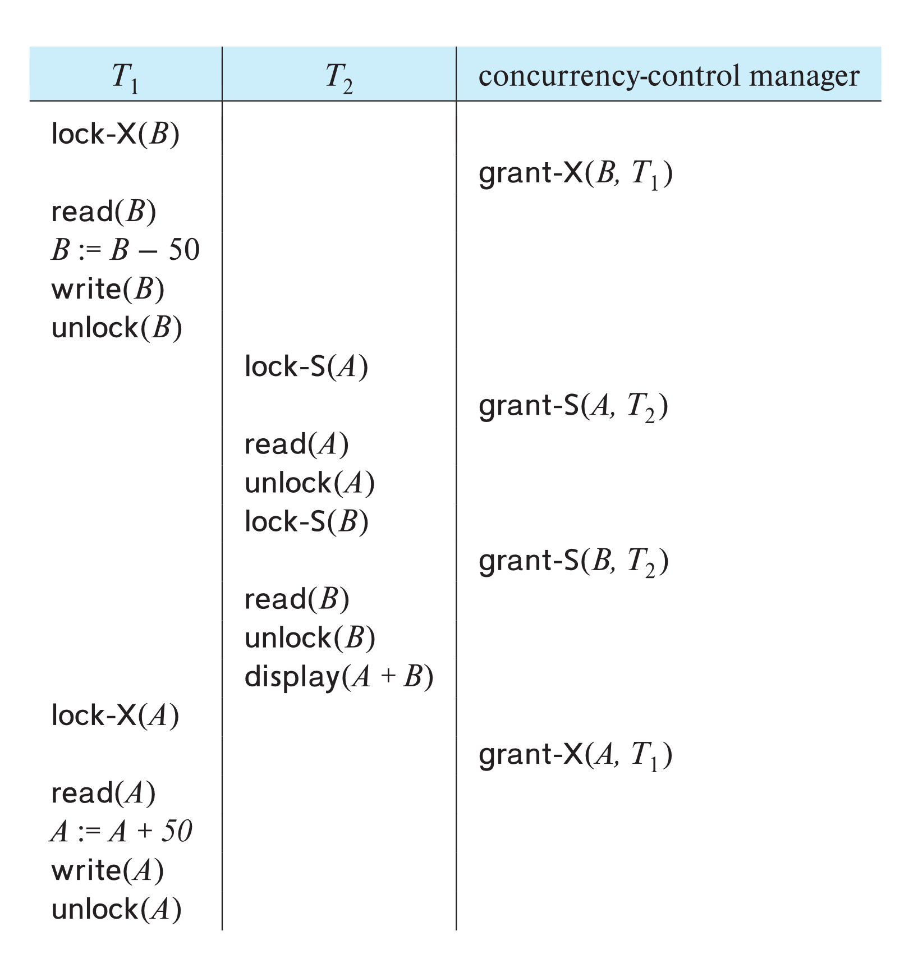
Schedule With Lock Grants
Grants omitted in rest of chapter
Assume grant happens just before the next instruction following lock request
This schedule is not serializable (why?)
A locking protocol is a set of rules followed by all transactions while requesting and releasing locks.
Locking protocols enforce serializability by restricting the set of possible schedules.

Slide 7
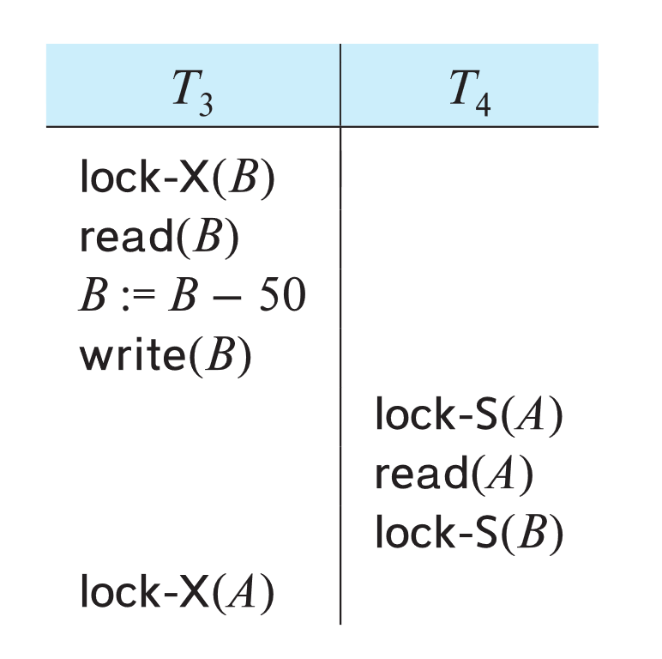
Deadlock
Consider the partial schedule
Neither T₃ nor T₄ can make progress — executing lock-S(B) causes T₄ to wait for T₃ to release its lock on B, while executing lock-X(A) causes T₃ to wait for T₄ to release its lock on A.
Such a situation is called a deadlock.
To handle a deadlock one of T₃ or T₄ must be rolled back and its locks released.

Slide 8
Deadlock (Cont.)
The potential for deadlock exists in most locking protocols. Deadlocks are a necessary evil.
Starvation is also possible if concurrency control manager is badly designed. For example:
A transaction may be waiting for an X-lock on an item, while a sequence of other transactions request and are granted an S-lock on the same item.
The same transaction is repeatedly rolled back due to deadlocks.
Concurrency control manager can be designed to prevent starvation.

Slide 9
The Two-Phase Locking Protocol
A protocol which ensures conflict-serializable schedules.
Phase 1: Growing Phase
Transaction may obtain locks
Transaction may not release locks
Phase 2: Shrinking Phase
Transaction may release locks
Transaction may not obtain locks
The protocol assures serializability. It can be proved that the transactions can be serialized in the order of their lock points (i.e., the point where a transaction acquired its final lock).
Locks
Time

Slide 10
The Two-Phase Locking Protocol (Cont.)
Two-phase locking does not ensure freedom from deadlocks
Extensions to basic two-phase locking needed to ensure recoverability of freedom from cascading roll-back
Strict two-phase locking: a transaction must hold all its exclusive locks till it commits/aborts.
Ensures recoverability and avoids cascading roll-backs
Rigorous two-phase locking: a transaction must hold all locks till commit/abort.
Transactions can be serialized in the order in which they commit.
Most databases implement rigorous two-phase locking, but refer to it as simply two-phase locking

Slide 11
The Two-Phase Locking Protocol (Cont.)
Two-phase locking is not a necessary condition for serializability
There are conflict serializable schedules that cannot be obtained if the two-phase locking protocol is used.
In the absence of extra information (e.g., ordering of access to data), two-phase locking is necessary for conflict serializability in the following sense:
Given a transaction T_{i} that does not follow two-phase locking, we can find a transaction T_{j} that uses two-phase locking, and a schedule for T_{i} and T_{j} that is not conflict serializable.

Slide 12
Locking Protocols
Given a locking protocol (such as 2PL)
A schedule S is legal under a locking protocol if it can be generated by a set of transactions that follow the protocol
A protocol ensures serializability if all legal schedules under that protocol are serializable

Slide 13
Lock Conversions
Two-phase locking protocol with lock conversions:
– Growing Phase:
can acquire a lock-S on item
can acquire a lock-X on item
can convert a lock-S to a lock-X (upgrade)
– Shrinking Phase:
can release a lock-S
can release a lock-X
can convert a lock-X to a lock-S (downgrade)
This protocol ensures serializability

Slide 14
Implementation of Locking
A lock manager can be implemented as a separate process
Transactions can send lock and unlock requests as messages
The lock manager replies to a lock request by sending a lock grant messages (or a message asking the transaction to roll back, in case of a deadlock)
The requesting transaction waits until its request is answered
The lock manager maintains an in-memory data-structure called a lock table to record granted locks and pending requests

Slide 15
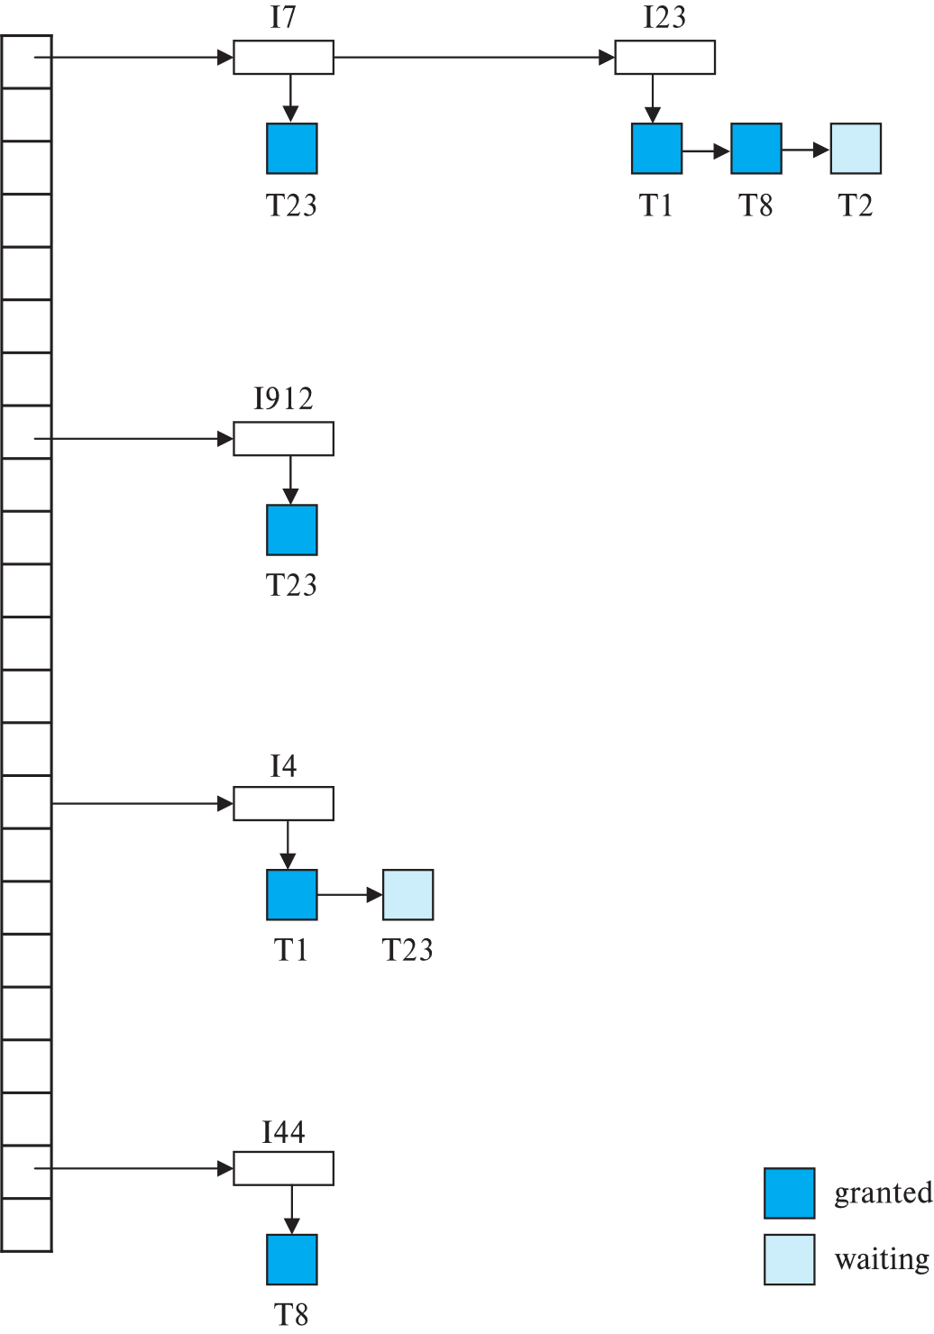
Lock Table
Dark rectangles indicate granted locks, light colored ones indicate waiting requests
Lock table also records the type of lock granted or requested
New request is added to the end of the queue of requests for the data item, and granted if it is compatible with all earlier locks
Unlock requests result in the request being deleted, and later requests are checked to see if they can now be granted
If transaction aborts, all waiting or granted requests of the transaction are deleted
lock manager may keep a list of locks held by each transaction, to implement this efficiently

Slide 16
Graph-Based Protocols
Graph-based protocols are an alternative to two-phase locking
Impose a partial ordering → on the set D = {d₁, d₂ ,..., d_{h}} of all data items.
If d_{i} → d_{j} then any transaction accessing both d_{i} and d_{j} must access d_{i} before accessing d_{j}.
Implies that the set D may now be viewed as a directed acyclic graph, called a database graph.
The tree-protocol is a simple kind of graph protocol.

Slide 17
Tree Protocol
Only exclusive locks are allowed.
The first lock by T_{i} may be on any data item. Subsequently, a data Q can be locked by T_{i} only if the parent of Q is currently locked by T_{i}.
Data items may be unlocked at any time.
A data item that has been locked and unlocked by T_{i} cannot subsequently be relocked by T_{i}

Slide 18
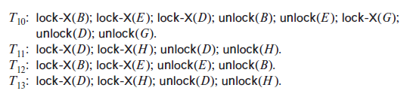
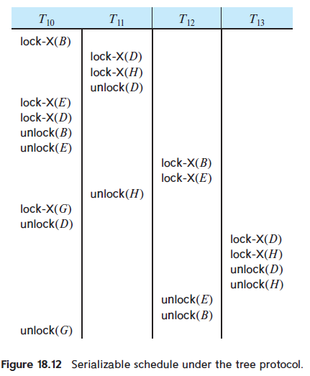
Graph-Based Protocols (Cont.)

Slide 19
Graph-Based Protocols (Cont.)
The tree protocol ensures conflict serializability as well as freedom from deadlock.
Unlocking may occur earlier in the tree-locking protocol than in the two-phase locking protocol.
Shorter waiting times, and increase in concurrency
Protocol is deadlock-free, no rollbacks are required
Drawbacks
Protocol does not guarantee recoverability or cascade freedom
Need to introduce commit dependencies to ensure recoverability
Transactions may have to lock data items that they do not access.
increased locking overhead, and additional waiting time
potential decrease in concurrency
Schedules not possible under two-phase locking are possible under the tree protocol, and vice versa.

Slide 20
Deadlock Handling
System is deadlocked if there is a set of transactions such that every transaction in the set is waiting for another transaction in the set.

Slide 21
Deadlock Handling
Deadlock prevention protocols ensure that the system will never enter into a deadlock state. Some prevention strategies:
Require that each transaction locks all its data items before it begins execution (pre-declaration).
Impose partial ordering of all data items and require that a transaction can lock data items only in the order specified by the partial order (graph-based protocol).

Slide 22
More Deadlock Prevention Strategies
wait-die scheme — non-preemptive
Older transaction may wait for younger one to release data item.
Younger transactions never wait for older ones; they are rolled back instead.
A transaction may die several times before acquiring a lock
wound-wait scheme — preemptive
Older transaction wounds (forces rollback) of younger transaction instead of waiting for it.
Younger transactions may wait for older ones.
Fewer rollbacks than wait-die scheme.
In both schemes, a rolled back transactions is restarted with its original timestamp.
Ensures that older transactions have precedence over newer ones, and starvation is thus avoided.

Slide 23
Deadlock prevention (Cont.)
Timeout-Based Schemes:
A transaction waits for a lock only for a specified amount of time. After that, the wait times out and the transaction is rolled back.
Ensures that deadlocks get resolved by timeout if they occur
Simple to implement
But may roll back transaction unnecessarily in absence of deadlock
Difficult to determine good value of the timeout interval.
Starvation is also possible

Slide 24
Deadlock Detection
Wait-for graph
Vertices: transactions
Edge from T_{i} →T_{j}. : if T_{i} is waiting for a lock held in conflicting mode byT_{j}
The system is in a deadlock state if and only if the wait-for graph has a cycle.
Invoke a deadlock-detection algorithm periodically to look for cycles.
Wait-for graph without a cycle
Wait-for graph with a cycle

Slide 25
Deadlock Recovery
When deadlock is detected :
Some transaction will have to rolled back (made a victim) to break deadlock cycle.
Select that transaction as victim that will incur minimum cost
Rollback -- determine how far to roll back transaction
Total rollback: Abort the transaction and then restart it.
Partial rollback: Roll back victim transaction only as far as necessary to release locks that another transaction in cycle is waiting for
Starvation can happen (why?)
One solution: oldest transaction in the deadlock set is never chosen as victim

Slide 26
Timestamp Based Concurrency Control

Slide 27
Timestamp-Based Protocols
Each transaction T_{i} is issued a timestamp TS(T_{i}) when it enters the system.
Each transaction has a unique timestamp
Newer transactions have timestamps strictly greater than earlier ones
Timestamp could be based on a logical counter
Real time may not be unique
Can use (wall-clock time, logical counter) to ensure
Timestamp-based protocols manage concurrent execution such that time-stamp order = serializability order
Several alternative protocols based on timestamps

Slide 28
Timestamp-Ordering Protocol
The timestamp ordering (TSO) protocol
Maintains for each data Q two timestamp values:
W-timestamp(Q) is the largest time-stamp of any transaction that executed write(Q) successfully.
R-timestamp(Q) is the largest time-stamp of any transaction that executed read(Q) successfully.
Imposes rules on read and write operations to ensure that
Any conflicting operations are executed in timestamp order
Out of order operations cause transaction rollback

Slide 29
Timestamp-Based Protocols (Cont.)
Suppose a transaction T_{i} issues a read(Q)
1. If TS(T_{i}) < W-timestamp(Q), then T_{i} needs to read a value of Q that
was already overwritten.
Hence, the read operation is rejected, and T_{i} is rolled back.
2. If TS(T_{i}) ≥ W-timestamp(Q), then the read operation is executed, and
R-timestamp(Q) is set to
max(R-timestamp(Q), TS(T_{i})).

Slide 30
Timestamp-Based Protocols (Cont.)
Suppose that transaction T_{i} issues write(Q).
1. If TS(T_{i}) < R-timestamp(Q), then the value of Q that T_{i} is producing
was needed previously, and the system assumed that that value
would never be produced.
Hence, the write operation is rejected, and T_{i} is rolled back.
2. If TS(T_{i}) < W-timestamp(Q), then T_{i} is attempting to write an
obsolete value of Q.
Hence, this write operation is rejected, and T_{i} is rolled back.
3. Otherwise, the write operation is executed, and W-timestamp(Q) is
set to TS(T_{i}).

Slide 31
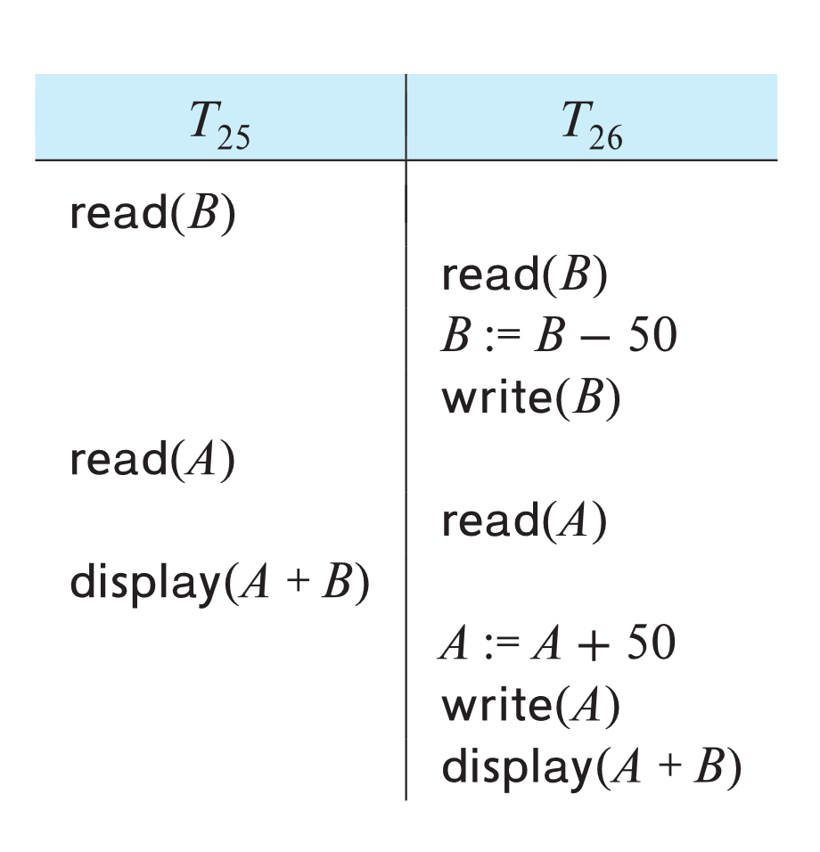
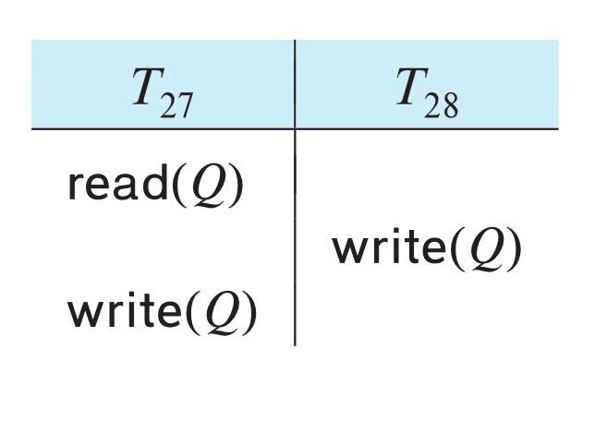
Example of Schedule Under TSO
Is this schedule valid under TSO?
Assume that initially:
R-TS(A) = W-TS(A) = 0
R-TS(B) = W-TS(B) = 0
Assume TS(T₂₅) = 25 and TS(T₂₆) = 26
How about this one, where initially R-TS(Q)=W-TS(Q)=0

Slide 32
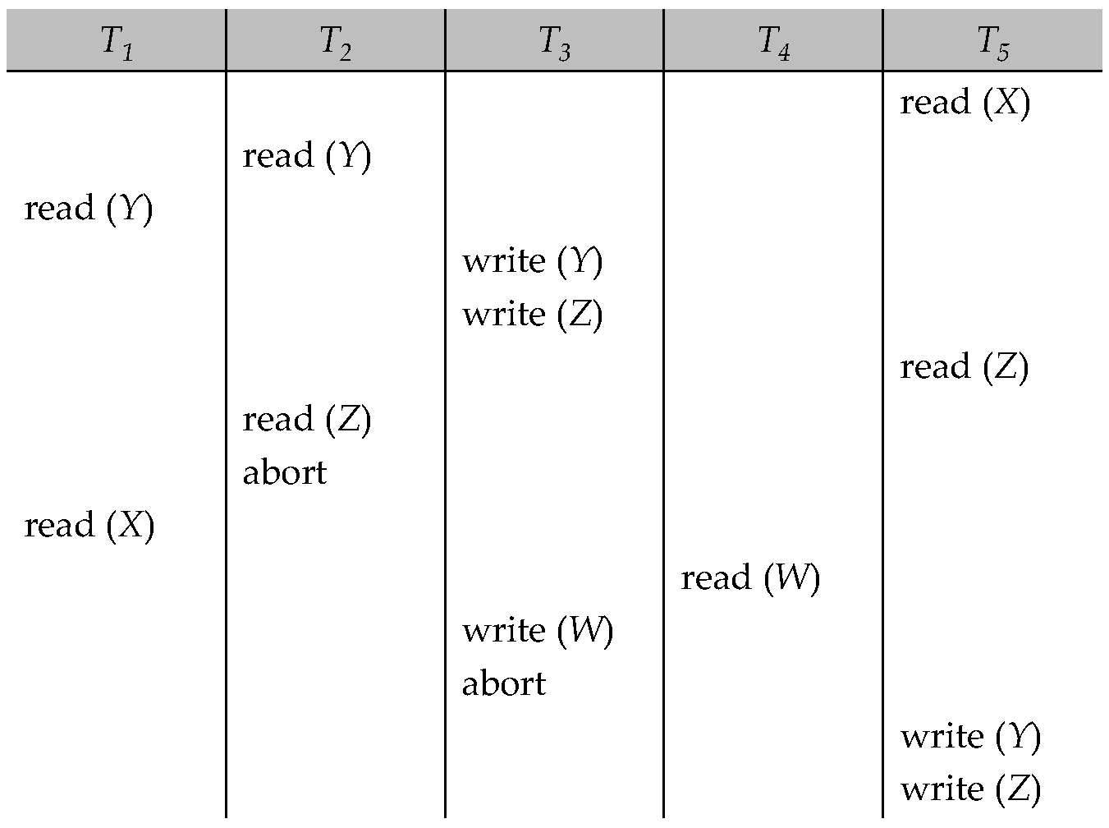
Another Example Under TSO
A partial schedule for several data items for transactions with
timestamps 1, 2, 3, 4, 5, with all R-TS and W-TS = 0 initially

Slide 33
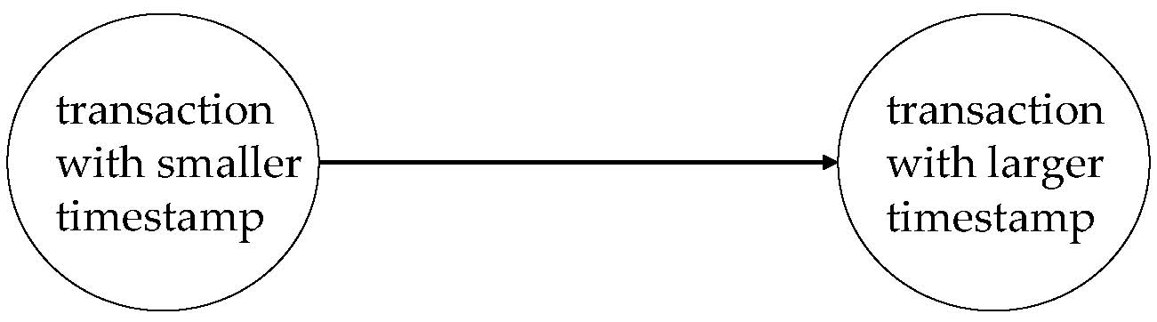
Correctness of Timestamp-Ordering Protocol
The timestamp-ordering protocol guarantees serializability since all the arcs in the precedence graph are of the form:
Thus, there will be no cycles in the precedence graph
Timestamp protocol ensures freedom from deadlock as no transaction ever waits.
But the schedule may not be cascade-free, and may not even be recoverable.

Slide 34
Recoverability and Cascade Freedom
Solution 1:
A transaction is structured such that its writes are all performed at the end of its processing
All writes of a transaction form an atomic action; no transaction may execute while a transaction is being written
A transaction that aborts is restarted with a new timestamp
Solution 2:
Limited form of locking: wait for data to be committed before reading it
Solution 3:
Use commit dependencies to ensure recoverability

